Slide 1
ChemE 485: Process Design I
Lecture 10: Cost of Manufacturing (Utilities)
Prof. Chad Curtis
Jan. 31, 2020

Slide 2
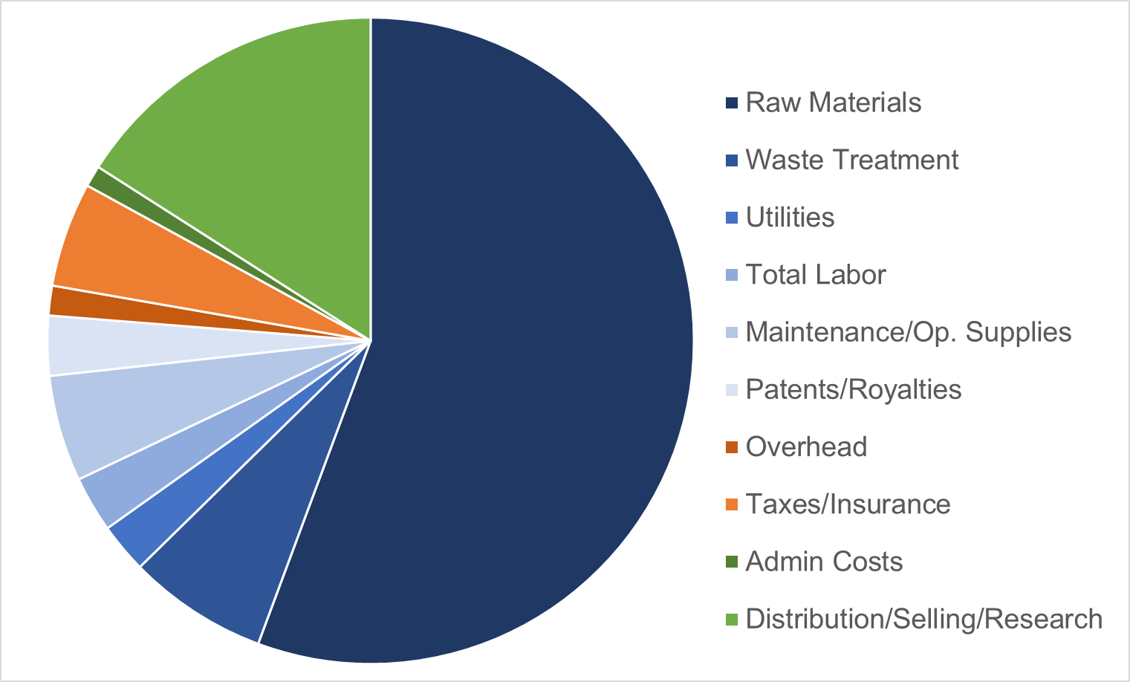
Cost of Manufacturing Breakdown

Slide 3
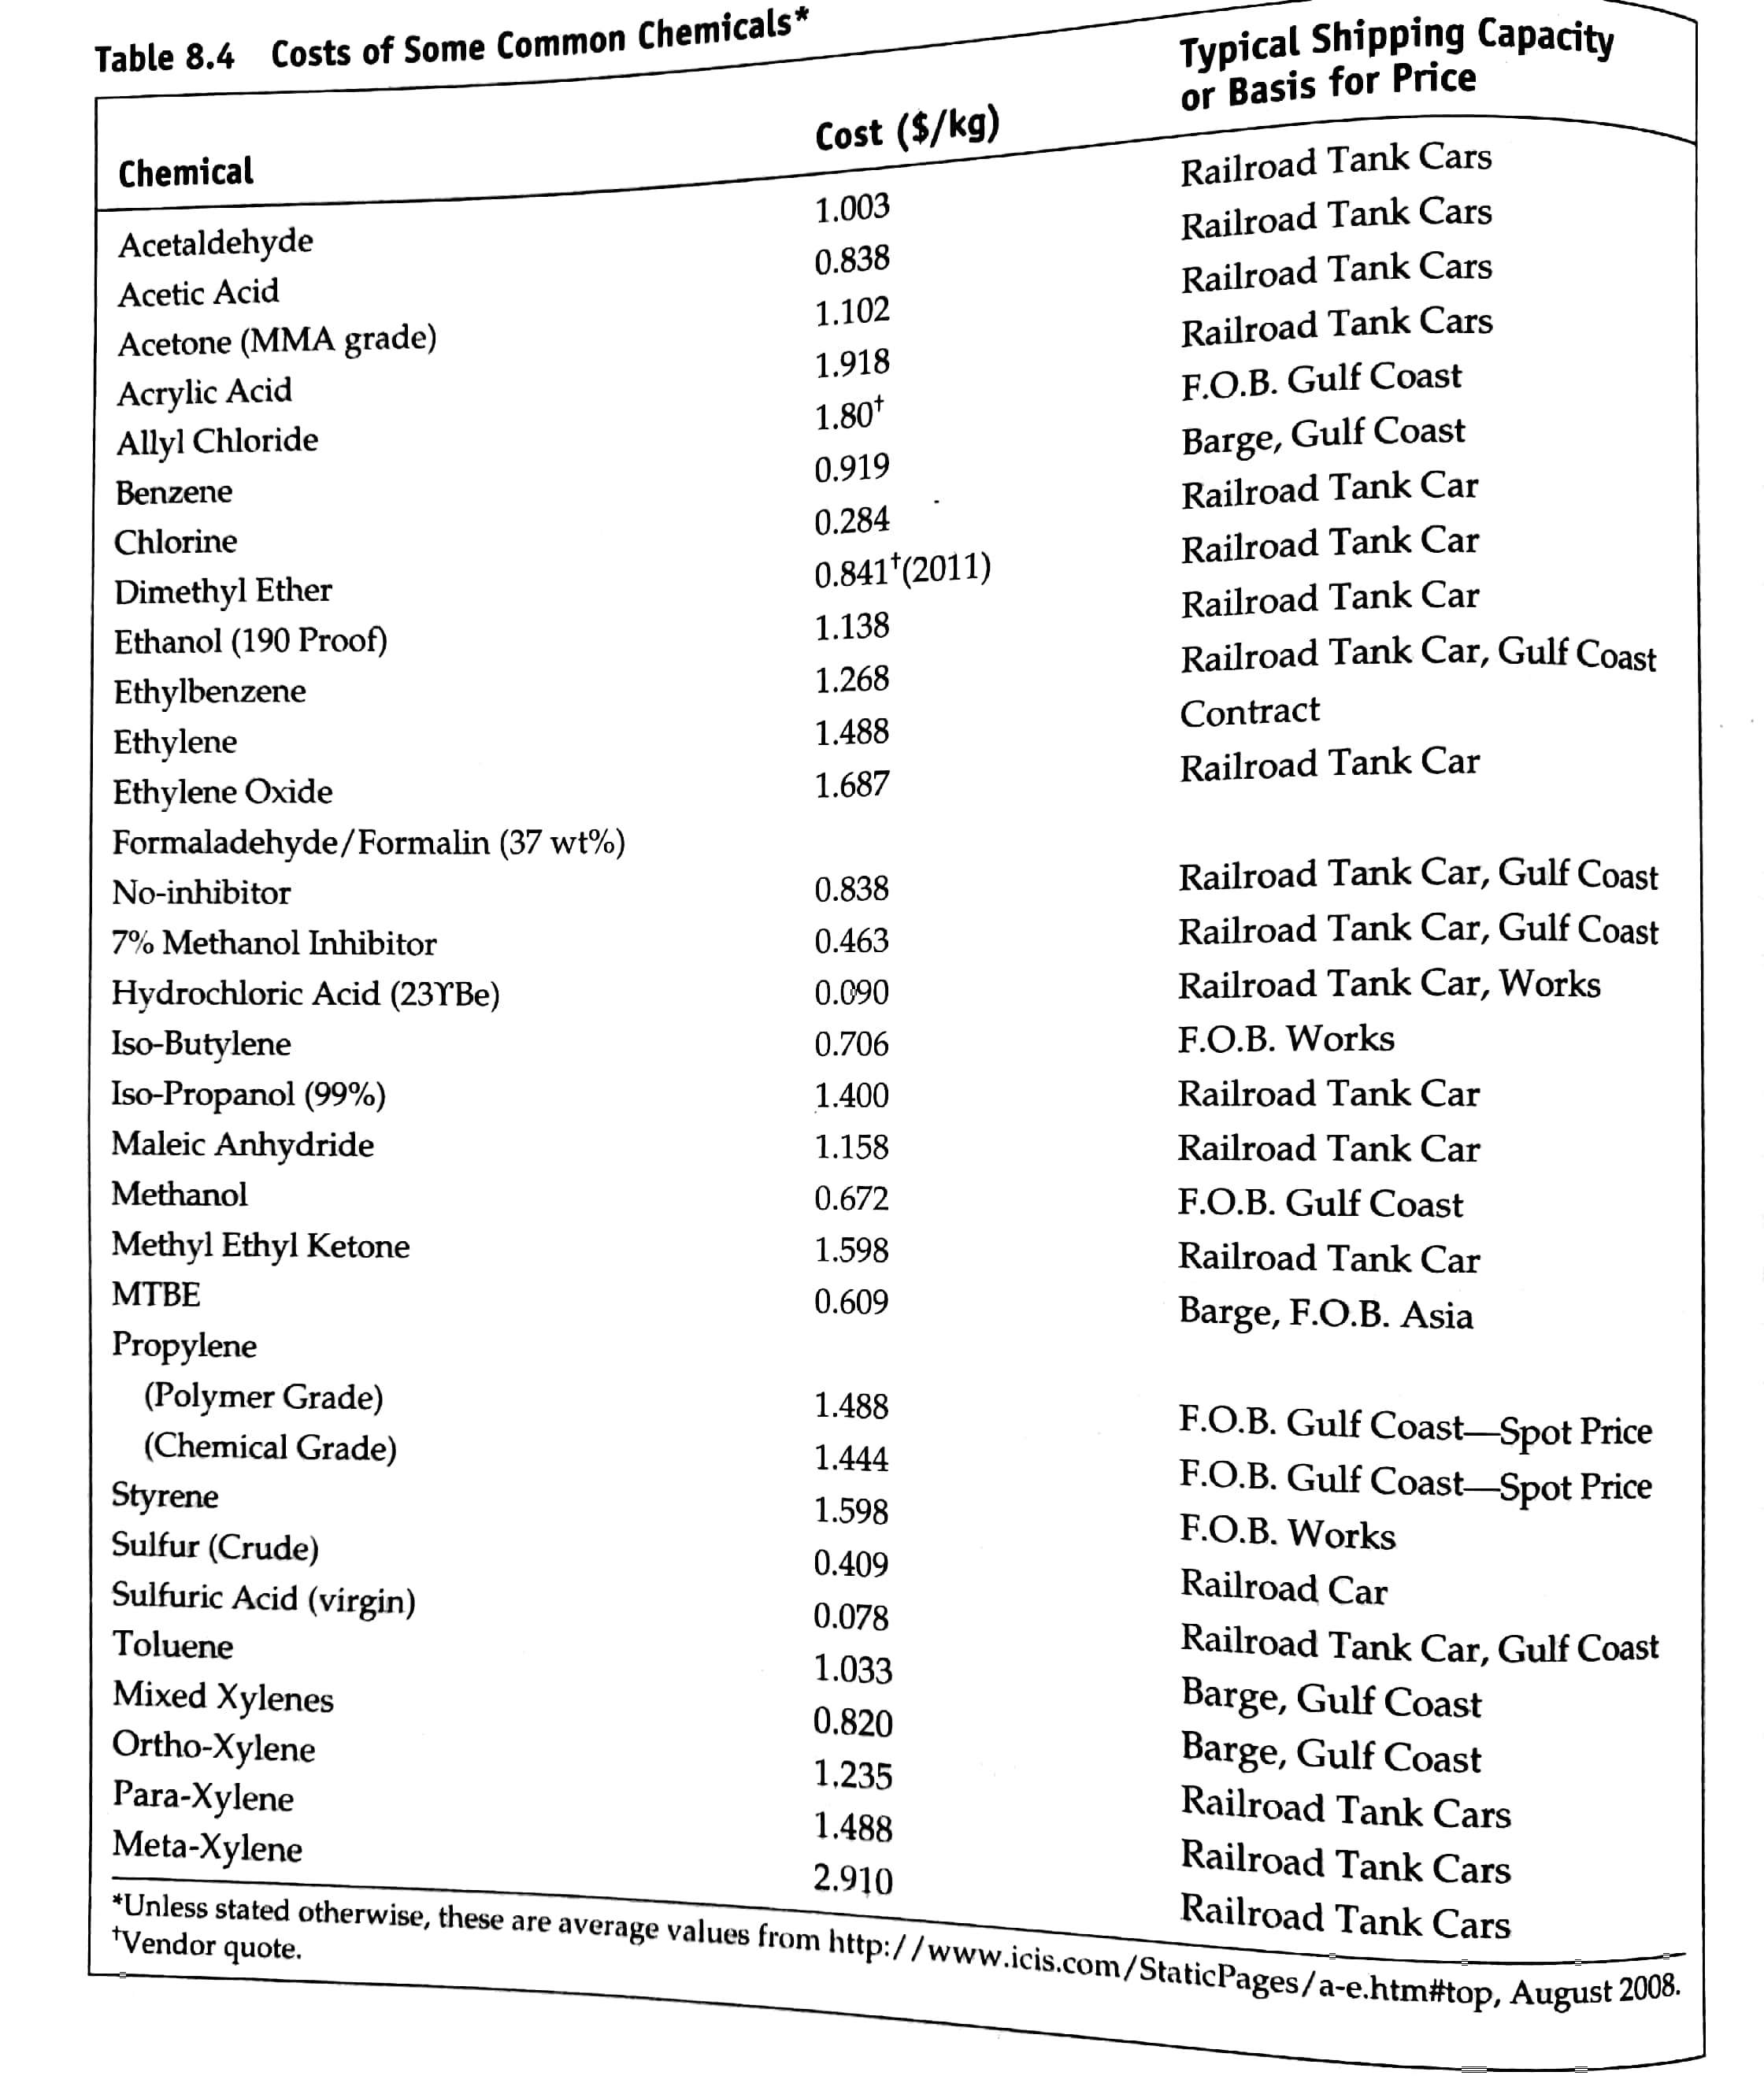
Raw Materials
Estimates of raw materials require a subscription to access these days (Chemical Market Reporter)
Companies often have short- and long-term contracts to get lower prices on raw materials (like going to Costco.

Slide 4
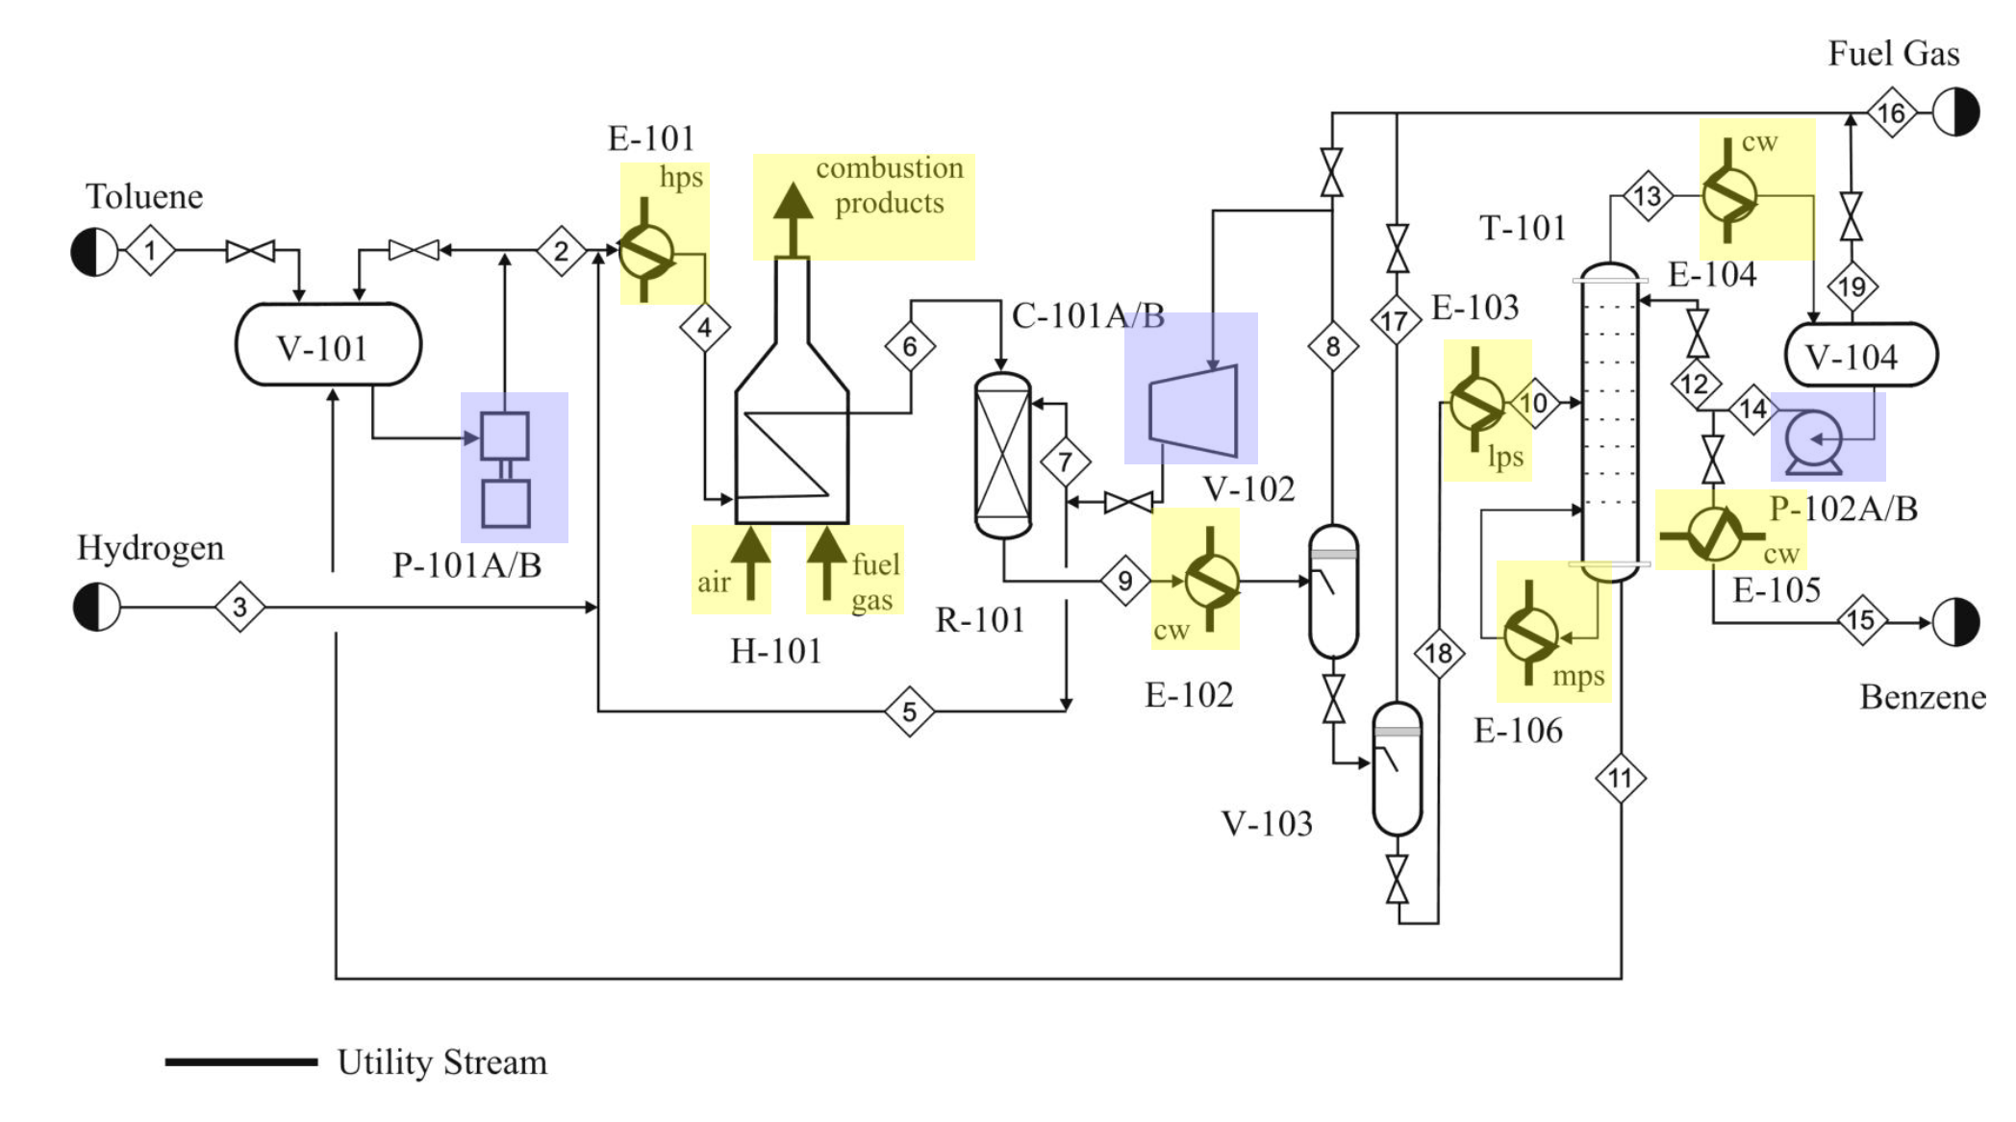
Utilities
Utilities are supplied by:
Purchased from a public or private utility
Supplied by the company
Self-generated and used by a single process unit

Slide 5
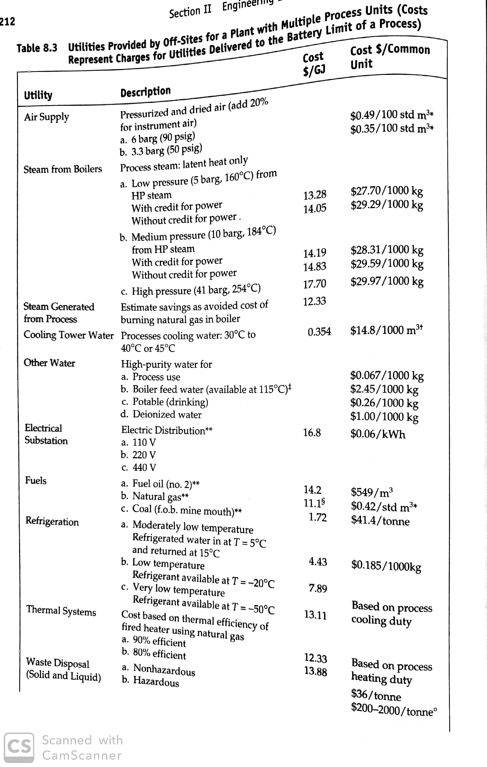
Utility Costs
Conventiently reported in terms of $/GJ. Otherwise you would have to do an energy balance.
Remember to take into account the stream factor!

Slide 6
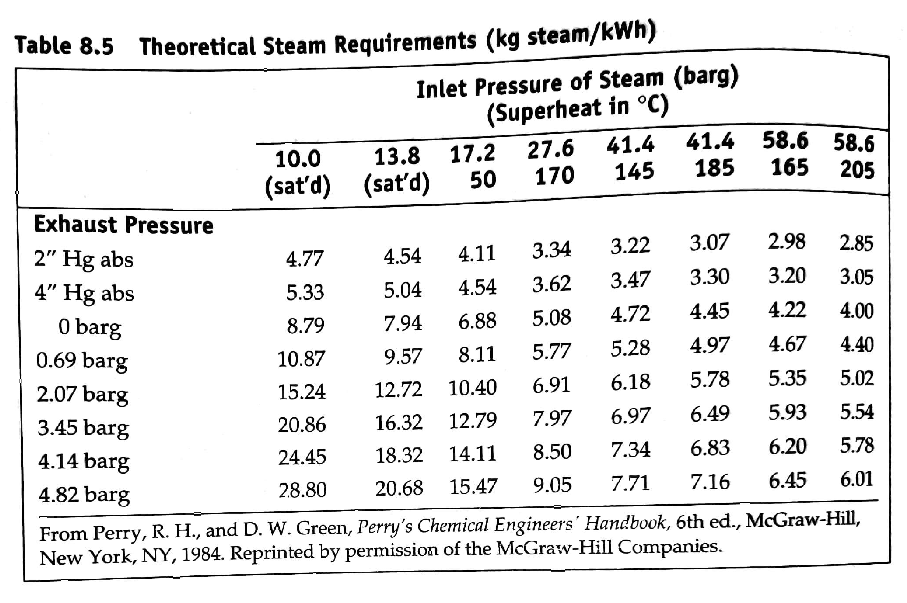
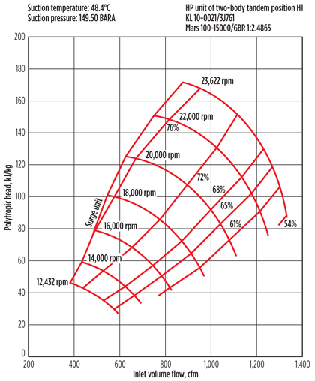
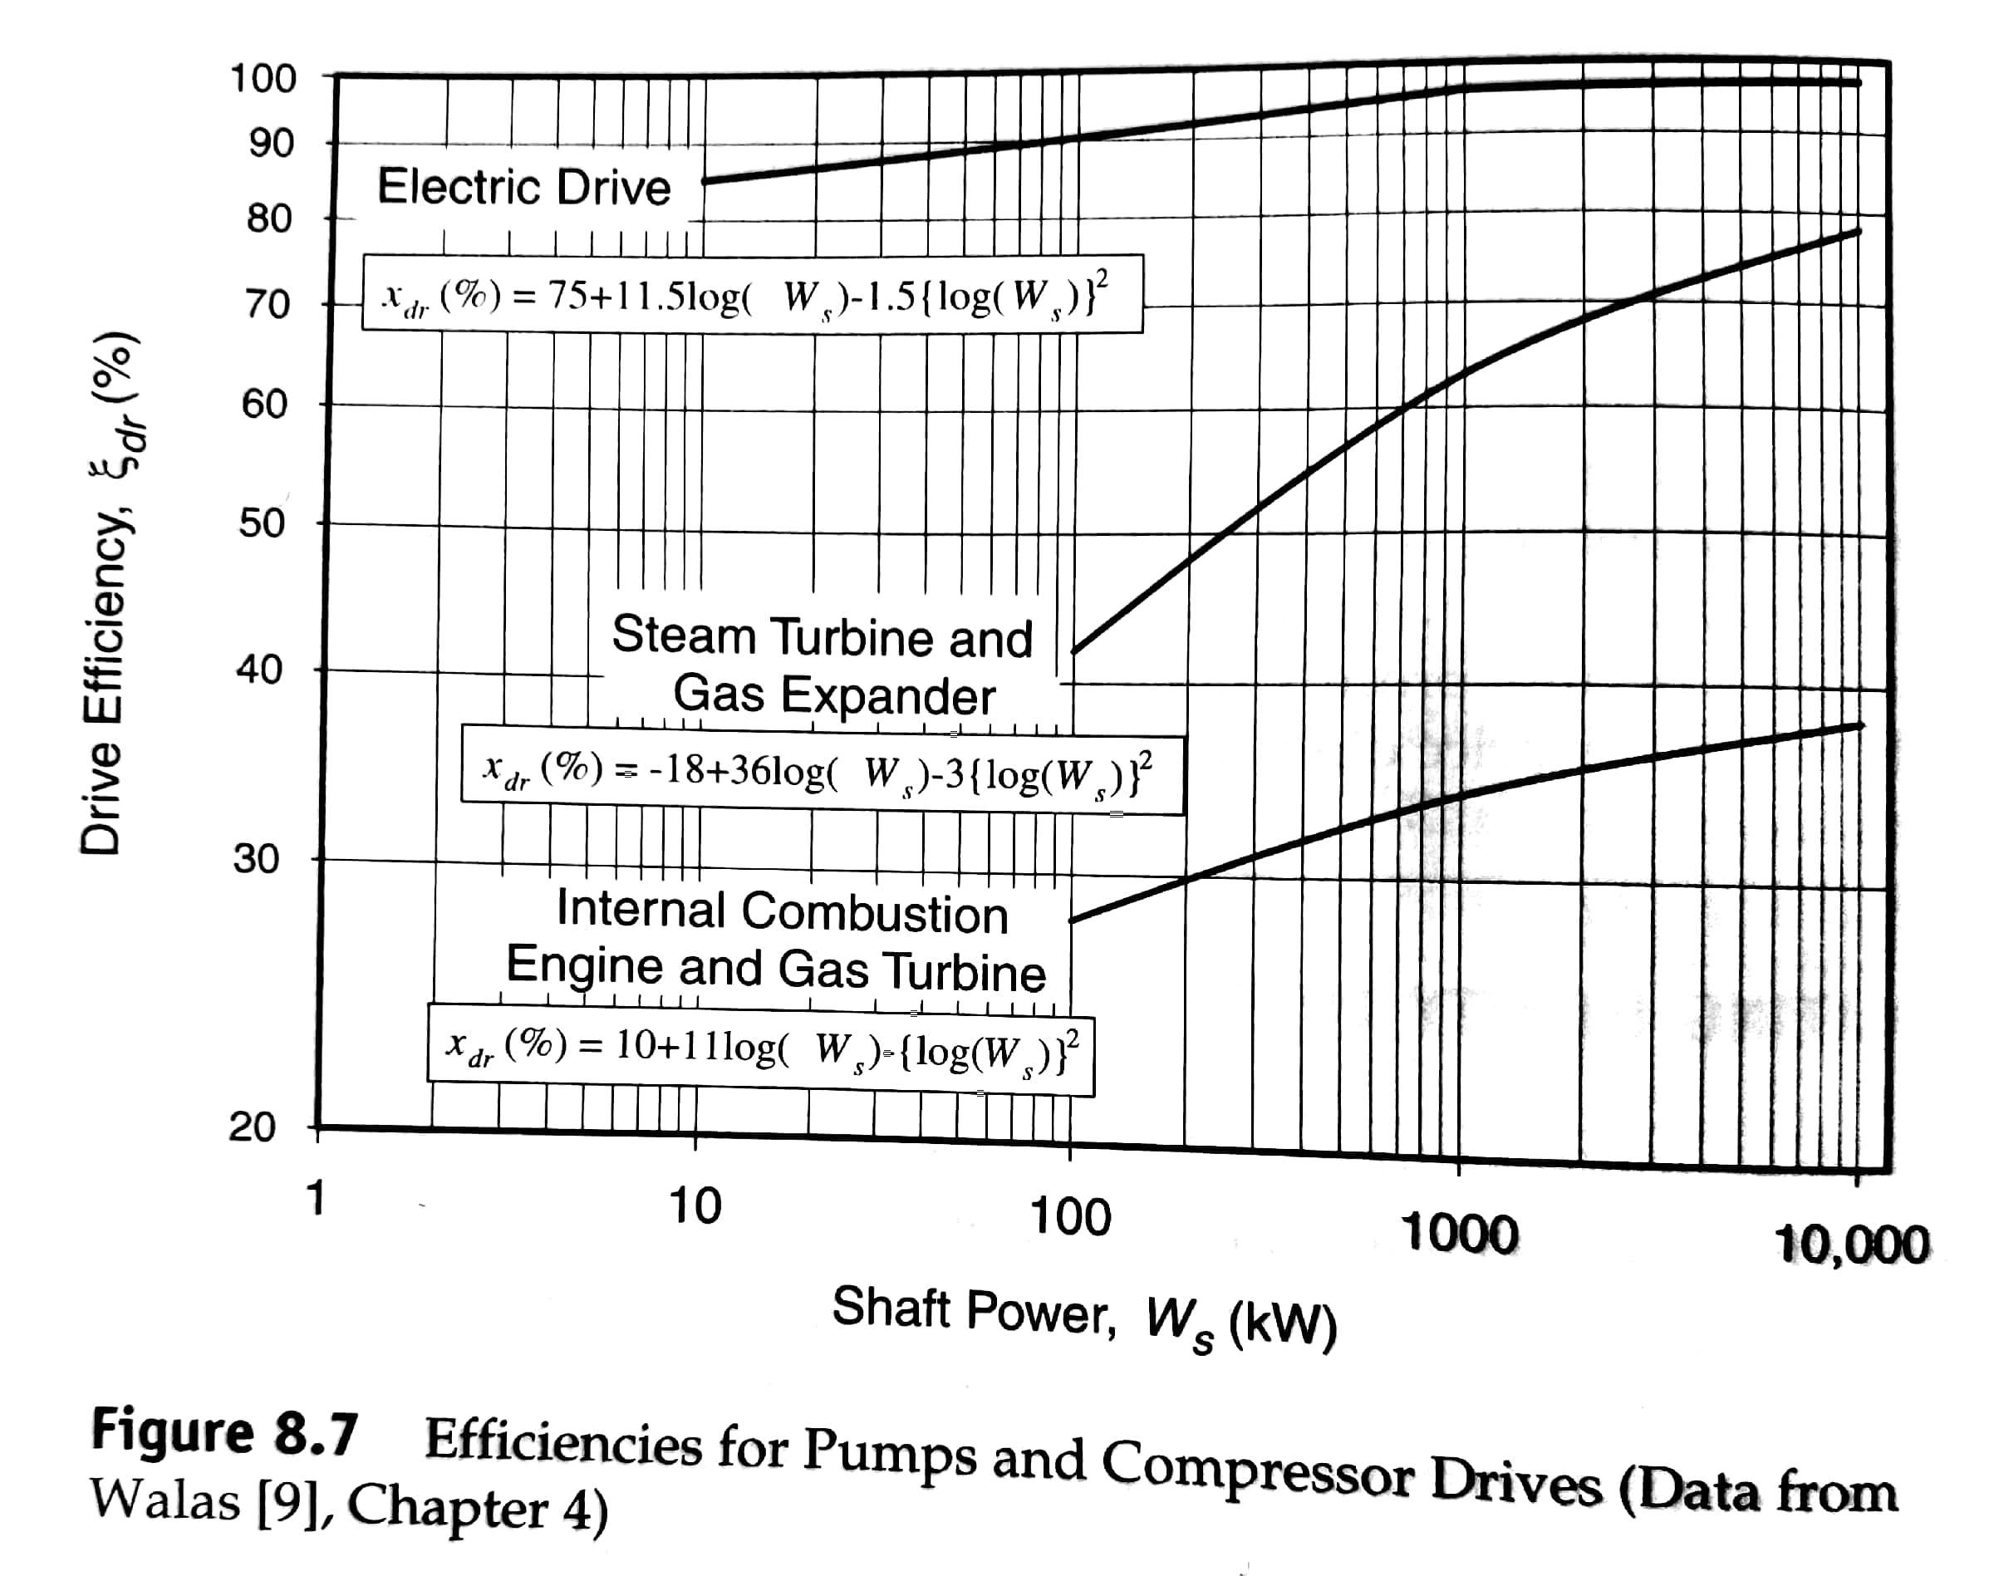
Compressor efficiencies

Slide 7
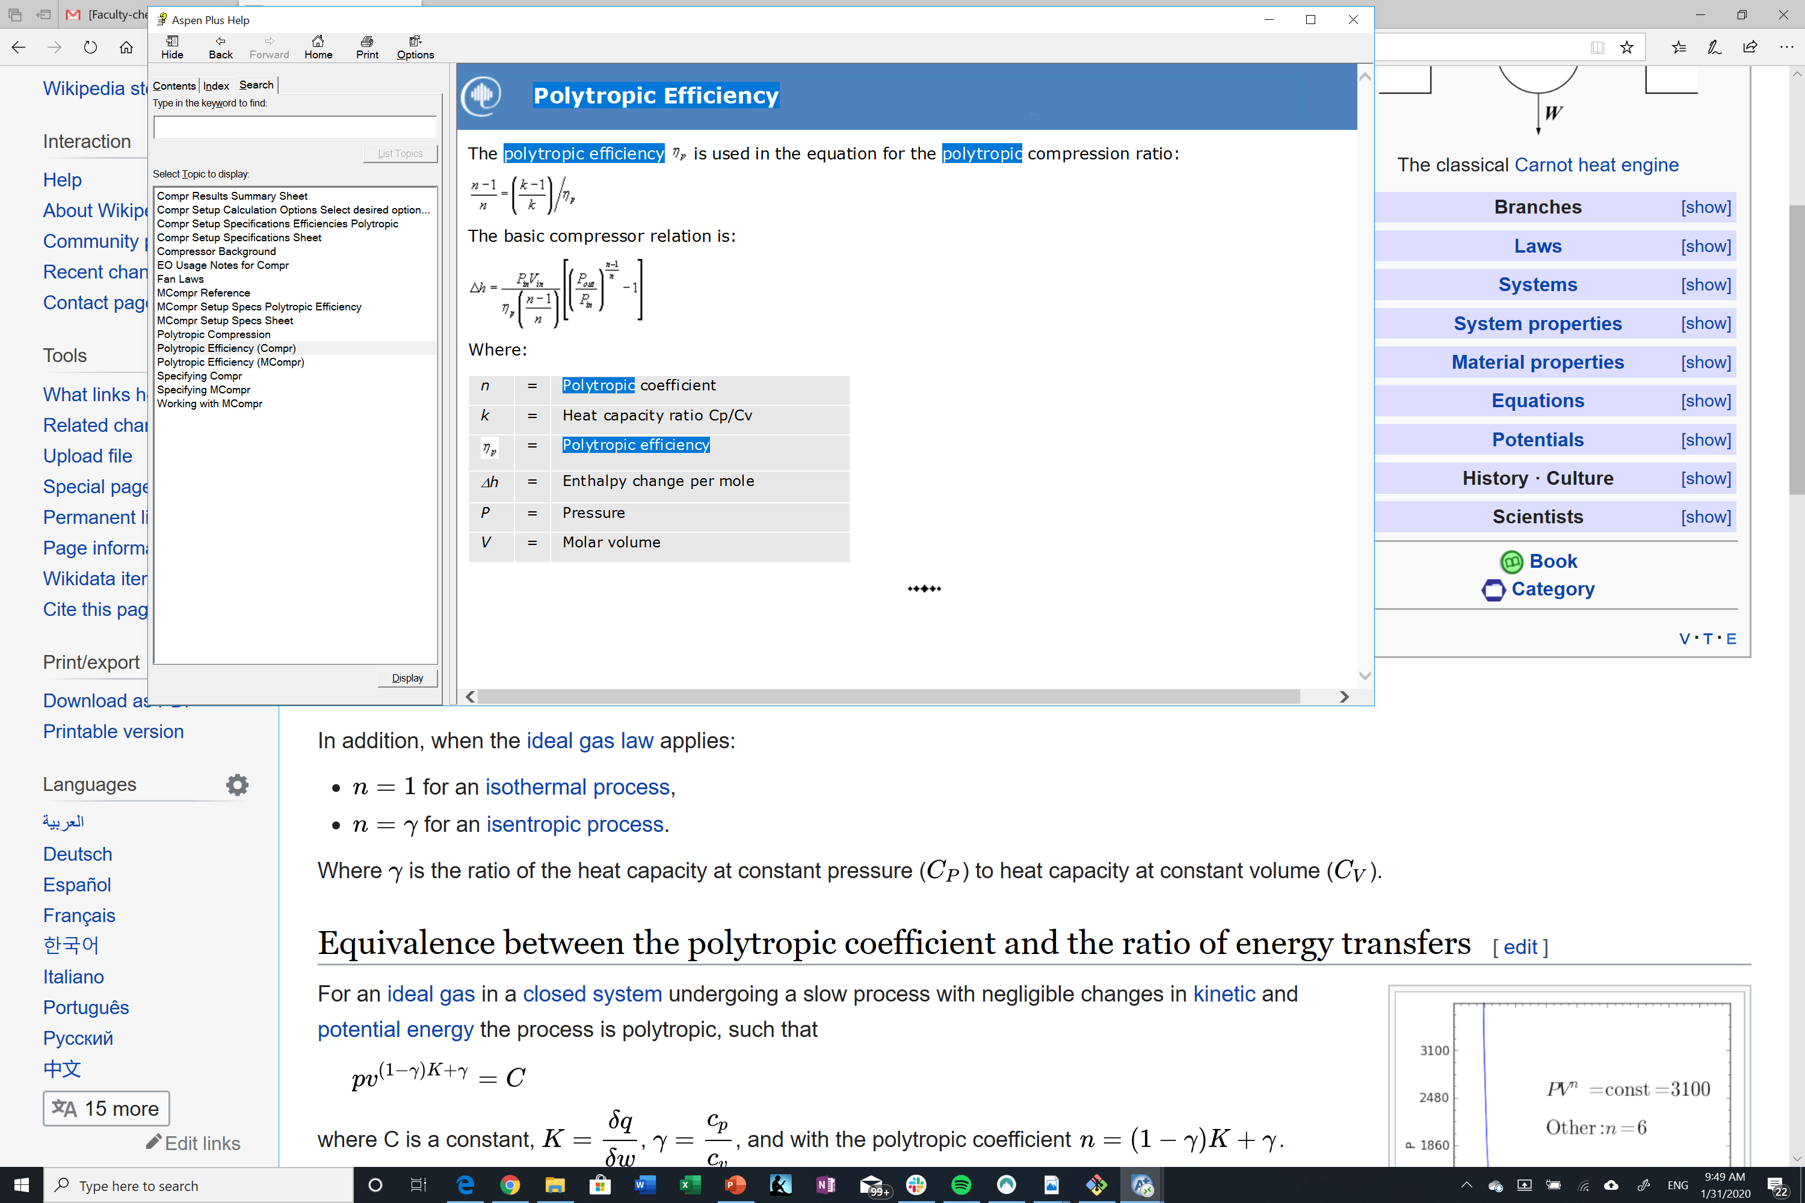
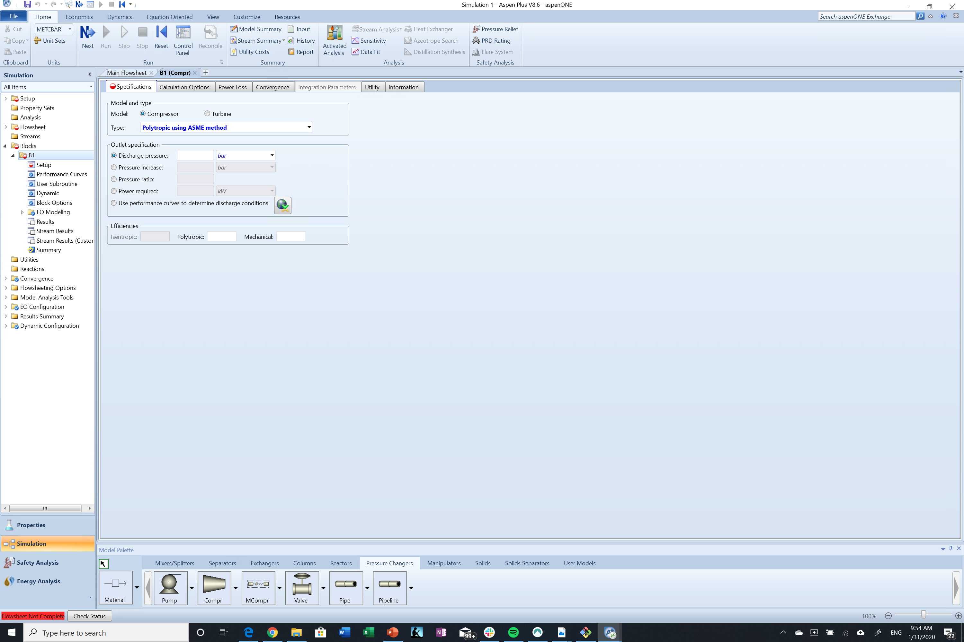
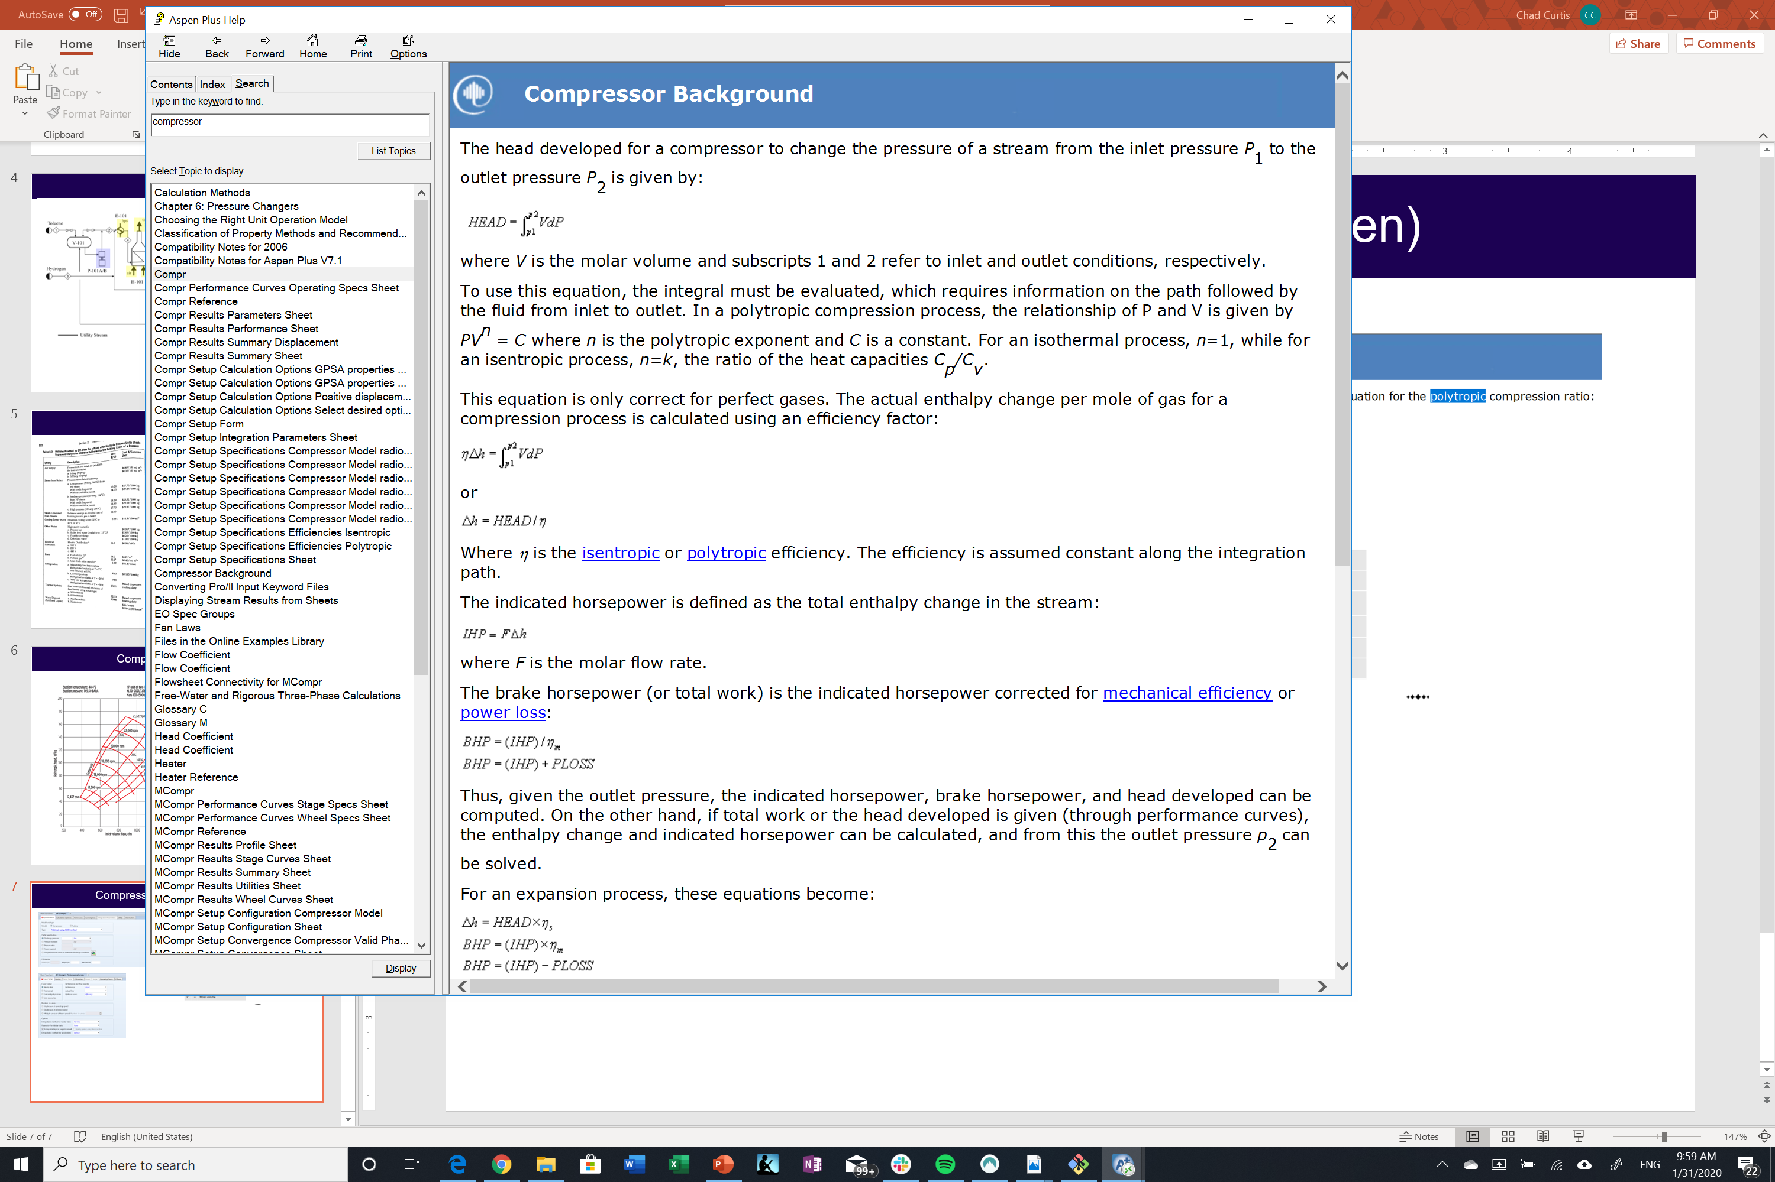
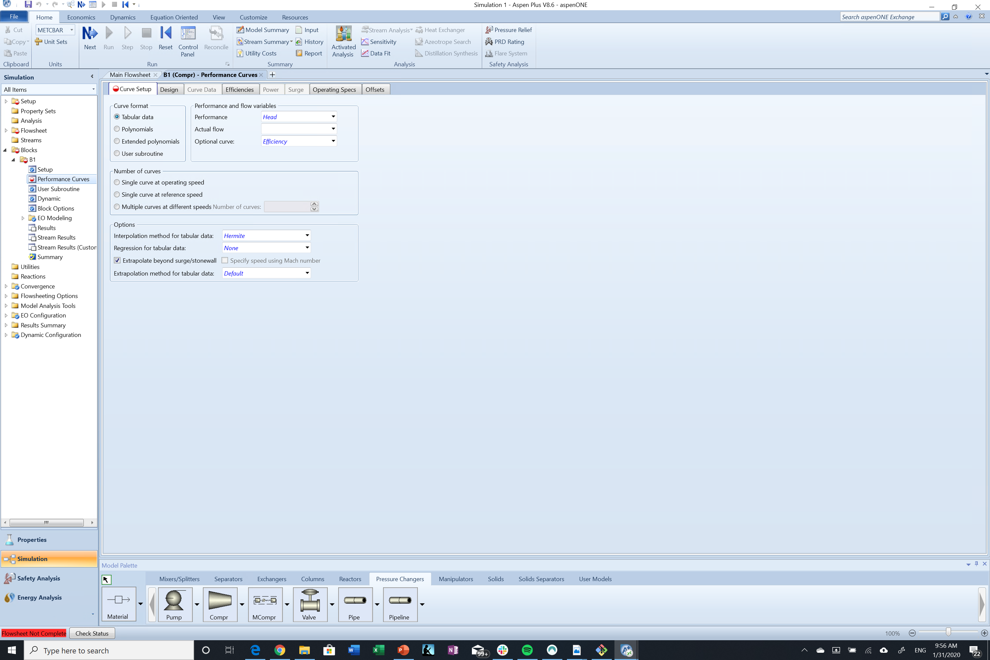
Compressor efficiencies (Aspen)

